Slide 1
New England marine mammal and sea turtle Stranding Data Analysis
Josh Meza-Fidalgo, Jess Ozog, Britney Pepper

Slide 2
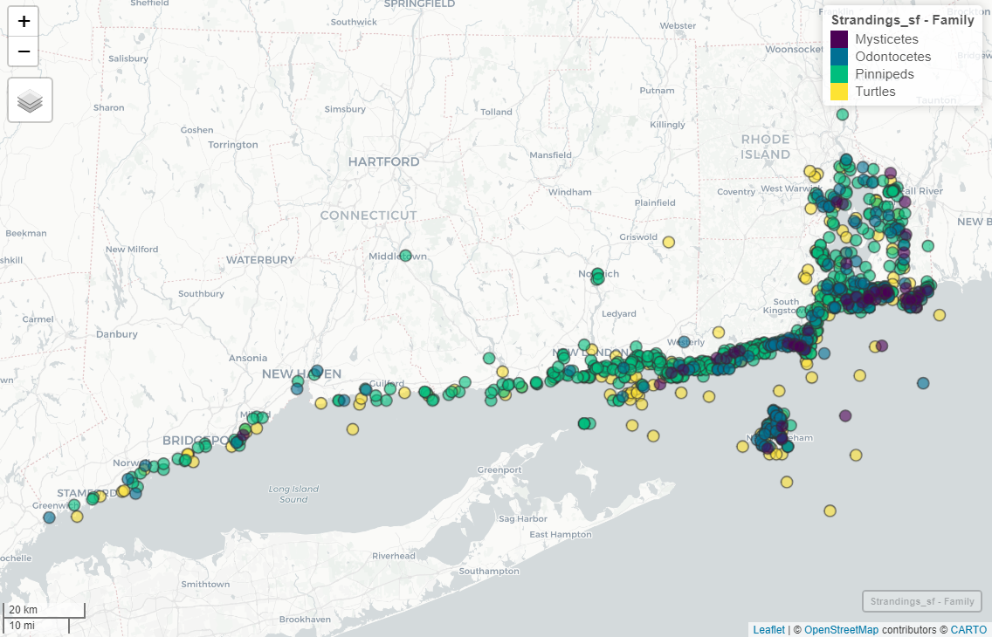
Data
Stranding data collected by Mystic Aquarium from 1990 – 2011
Spatial range: Connecticut and Rhode Island
Curated & managed by OBIS-SEAMAP
1,140 cetacean, pinniped, and sea turtle strandings
679 Pinnipeds
256 Turtles
155 Odontocetes
50 Mysticetes

Slide 3
Questions
Are there any significant differences between years and/or months for strandings for each family group?
How are the strandings related geospatially? Are there potential stranding hotspots?
Are there any temporal trends/patterns?

Slide 4
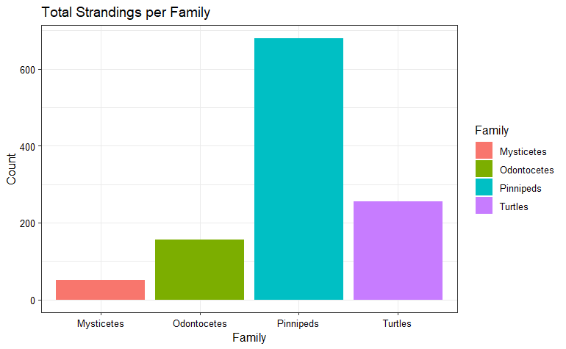
Wrangling and exploration
Divided into 4 families for specific analyses
Pinnipeds
Turtles
Mysticetes (baleen whales)
Odontocetes (toothed whales)
Further wrangling to determine # of strandings of each family by year and month
Geospatial Wrangling

Slide 5
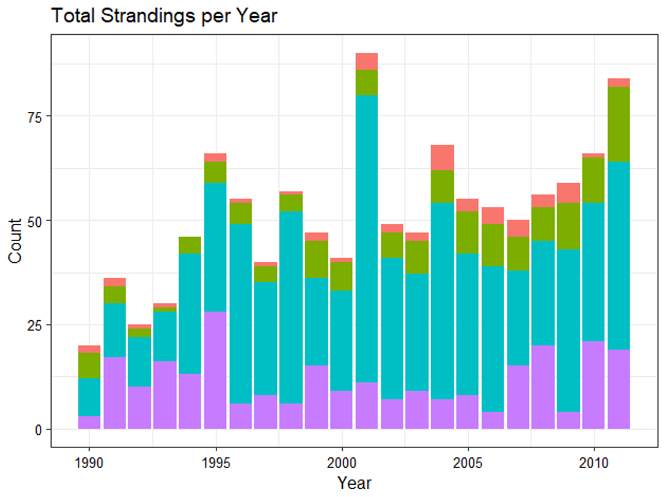
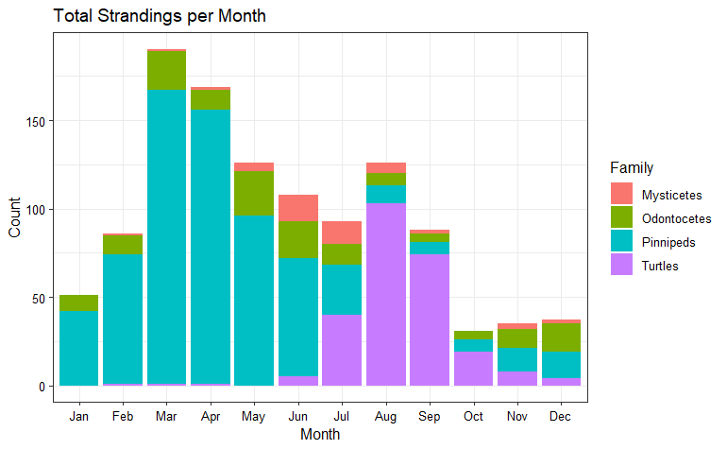
Strandings summary

Slide 6
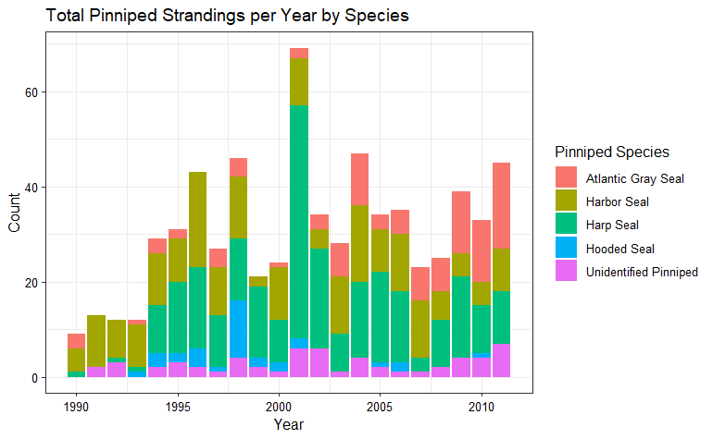
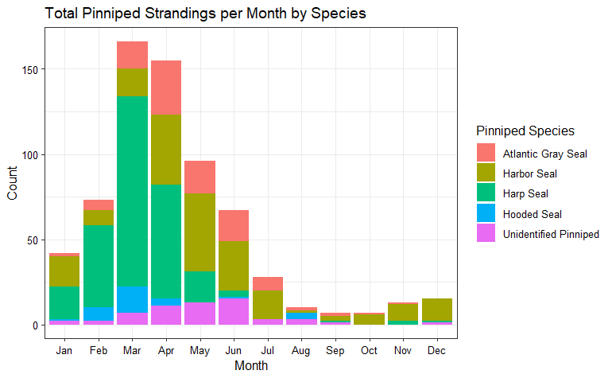
Pinnipeds

Slide 7
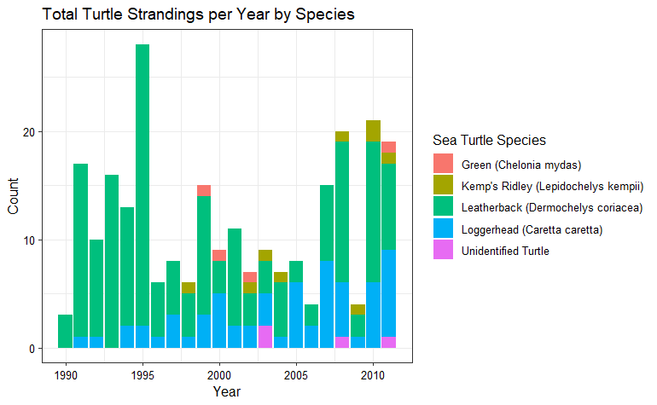
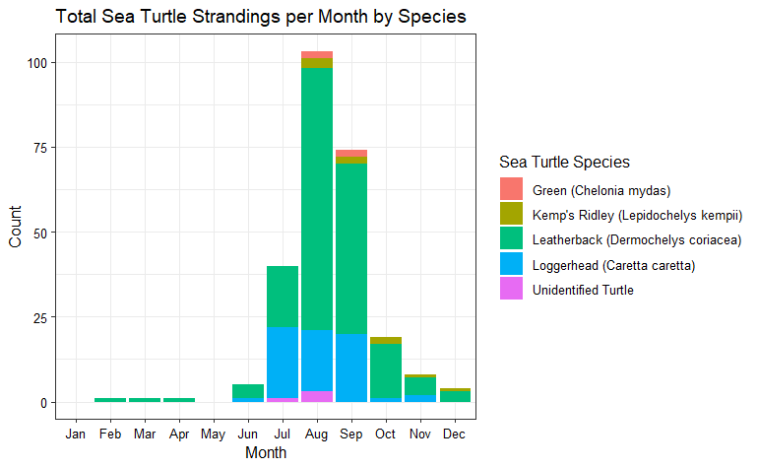
Sea turtles:
1995: most statistically different (p-value < 0.05)
July – September: most statistically different (p-values < 0.05)

Slide 8
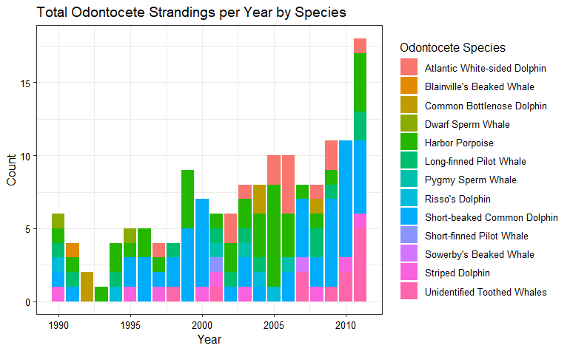
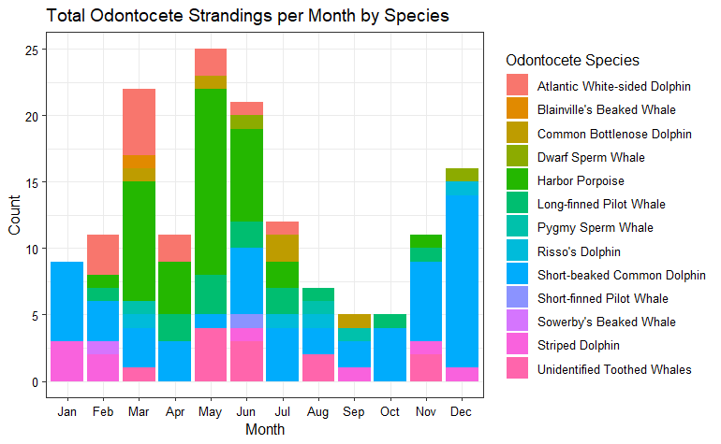
odontocetes

Slide 9
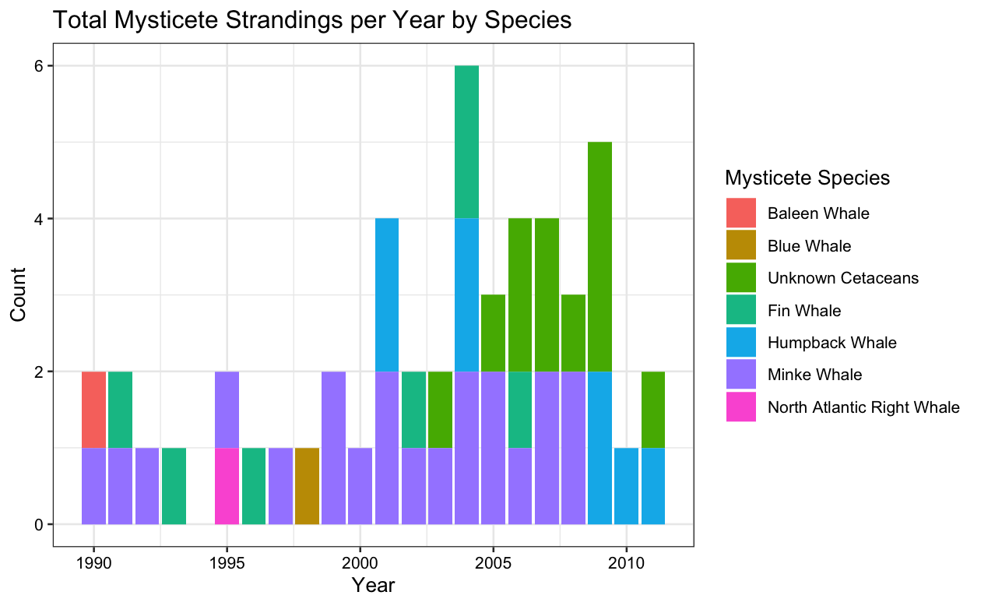
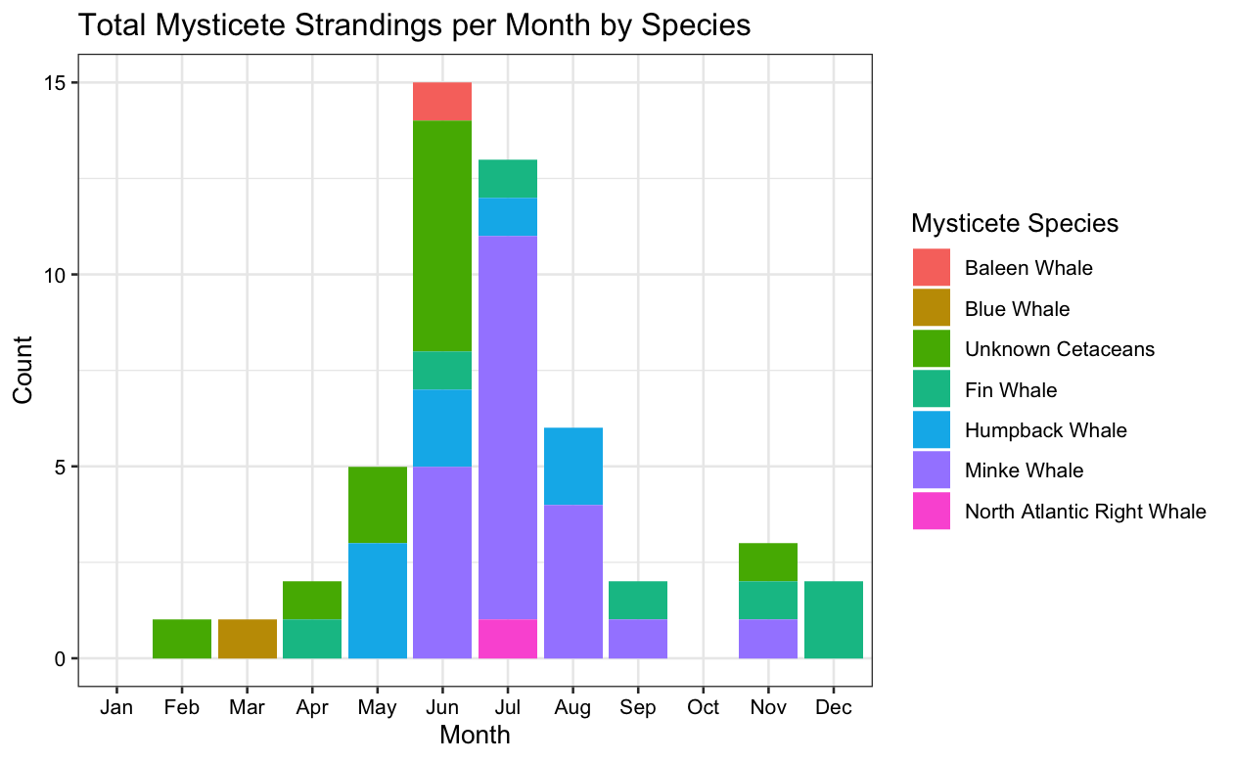
Mysticetes

Slide 10
Geospatial analysis
Pinnipeds
Sea Turtles
Of the 256 total strandings, 205 of them were within 40,000m of mean latitude and longitude
Odontocetes
Of the 155 total strandings, 125 of them were within 40,000m of mean latitude and longitude, and 20 of them were within 40,000 - 60,000m.
Mysticetes
Of the 50 total strandings, 44 of them were within 40,000m of mean latitude and longitude

Slide 11
Summary
Pinnipeds
Years and months are statistically significant for number of strandings
“Mean” stranding area (and distances from) determined
Yearly increasing trend in strandings
Possible seasonality – pupping season?
Sea turtles
Concentrated to summer months (corresponds with nesting season)
Majority occur within 40,000m of each other – potential hotspot?
Odontocetes
Total number of strandings have increased over the years
Strandings appear regularly over the months
Mysticetes
Concentrated during months of June and July
Much fewer total strandings over the study period
Increased amounts of stradings after the year 2000
Understanding how strandings change annually and monthly is necessary for stranding prevention and response, resource allocation, and conservation management
To improve this analysis, would be beneficial to have additional data on cause of death
***Time series results are TBD***

